Slide 1
Russia–Ukraine War: Military Equipment Losses Analysis
By
Praveen Kumar

Slide 2
Objective of the Analysis
Analyze total equipment losses by country
Compare losses across equipment categories
Identify trends and dominance patterns
Build an interactive Power BI dashboard for decision- making

Slide 3
DATASET OVERVIEW
Dataset Description :
Source: Open war-loss tracking dataset
Countries: Russia & Ukraine
Equipment Types:
  Tanks
  Armored Vehicles
  Aircraft
  Helicopters
  Artillery
  Naval & Air Defense
Granularity: Equipment-wise losses

Slide 4
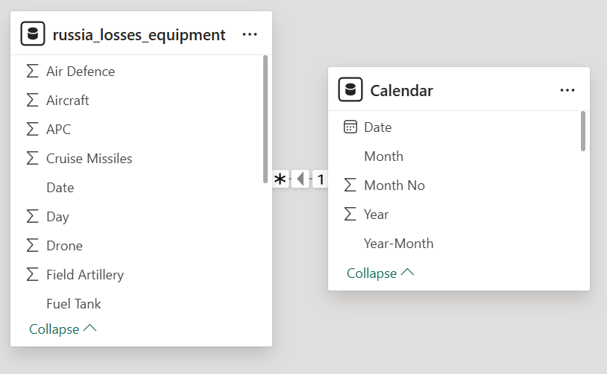
DATA CLEANING & PREPARATION (POWERQUERY)
Data Cleaning Steps
Removed null and duplicate records
Renamed columns for clarity
Converted data types correctly
Standardized equipment category names
Structured data for DAX calculations

Slide 5
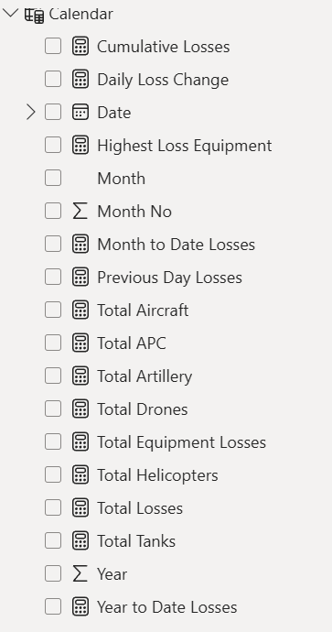
KEY DAX MEASURES USED
Important DAX Calculations
Total Equipment Losses
Losses by Country
Losses by Equipment Type
Percentage Share of Losses
Comparative Difference between Countries
Example :
Total Losses = SUM(Losses[Count])

Slide 6
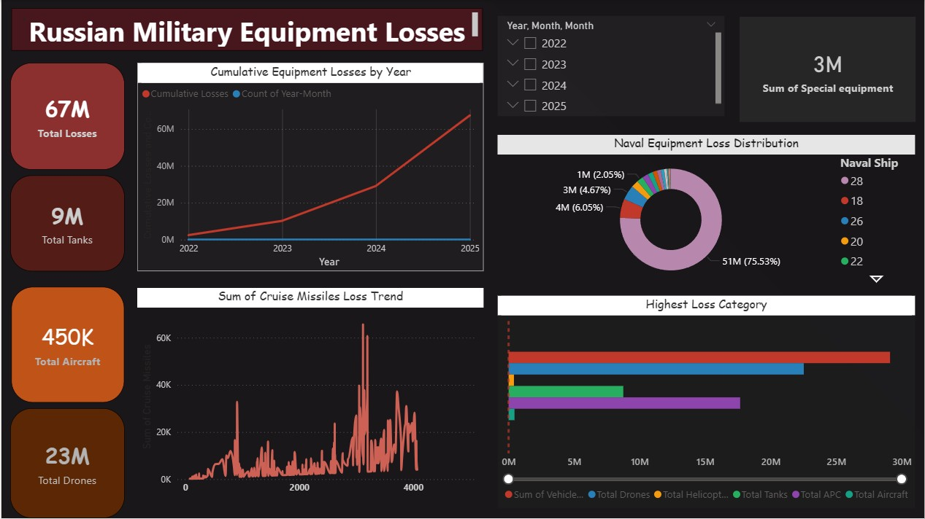
DASHBOARD OVERVIEW

Slide 7
KEY INSIGHTS FROM ANALYSIS
Insights Identified
Russia has higher losses in heavy equipment like tanks
Ukraine shows fewer losses but more concentrated categories
Armored vehicles and artillery form major loss segments
Air equipment losses are comparatively lower

Slide 8
INTERACTIVITY & USER EXPERIENCE
Why Power BI?
Dynamic slicers
Drill-down capability
Cross-highlighting visuals
Real-time filtering
Easy stakeholder understanding

Slide 9
PROJECT VALUE & USE CASE
Demonstrates real-world analytical thinking
Shows Power BI end-to-end skills
Useful for defense analysis, journalism, and research
Strong portfolio project for data roles

Slide 10
CONCLUSION
Data visualization simplifies complex war data
Power BI enables effective comparison
Interactive dashboards improve decision-making
Project demonstrates analytical and technical proficiency

Slide 11
Thank You

